Slide 1
Linear algebra:
Diagonalization and Markov matrices
主讲人：常万里

Slide 2

Reference
MIT 18.06 Linear Algebra
https://ocw.mit.edu/courses/mathematics/18-06-linear-algebra-spring-2010/
http://open.163.com/special/opencourse/daishu.html

Slide 3
Index
Diagonalizing a matrix S⁻¹ AS = Λ
Power of A
Markov matrices
PageRank

Slide 4
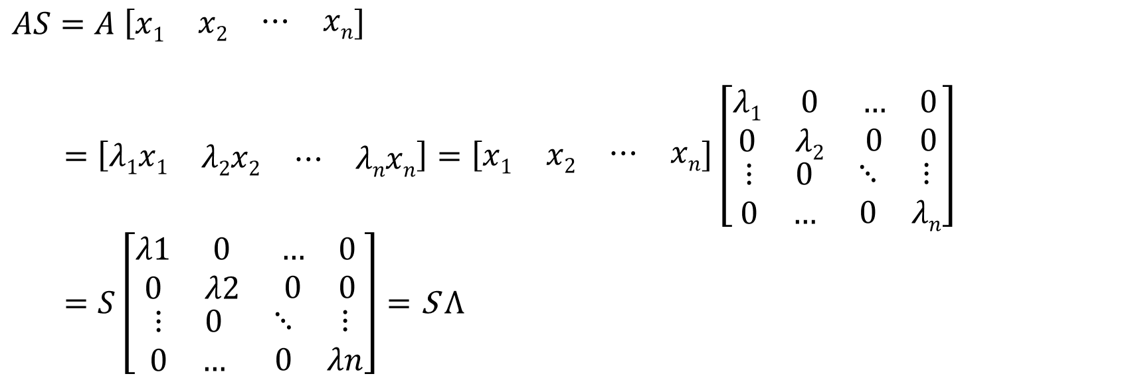
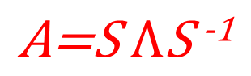
Diagonalizing a matrix S⁻¹ AS = Λ
If A (with R ^{n*n}) has n linearly independent eigenvectors, we can put those vectors in the columns of a (square, invertible) matrix S. Then
$$AS=A \left[\begin{matrix}x1 & \begin{matrix}x2 & \begin{matrix}⋯ & xn\end{matrix}\end{matrix}\end{matrix}\right]$$
$=$ $\left[λ1\begin{matrix}x1 & \begin{matrix}λ2x2 & \begin{matrix}⋯ & λnxn\end{matrix}\end{matrix}\end{matrix}\right]=\left[\begin{matrix}x1 & \begin{matrix}x2 & \begin{matrix}⋯ & xn\end{matrix}\end{matrix}\end{matrix}\right]\left[\begin{matrix}\begin{matrix}λ1 & 0 \\ 0 & λ2\end{matrix} & \begin{matrix}… & 0 \\ 0 & 0\end{matrix} \\ \begin{matrix}⋮ & 0 \\ 0 & …\end{matrix} & \begin{matrix}⋱ & ⋮ \\ 0 & λn\end{matrix}\end{matrix}\right]$
$=S\left[\begin{matrix}\begin{matrix}λ1 & 0 \\ 0 & λ2\end{matrix} & \begin{matrix}… & 0 \\ 0 & 0\end{matrix} \\ \begin{matrix}⋮ & 0 \\ 0 & …\end{matrix} & \begin{matrix}⋱ & ⋮ \\ 0 & λn\end{matrix}\end{matrix}\right]=\text{S} \text{Λ}$
$$\text{A}\text{=}\text{S} \text{Λ}\text{S} \text{-1}$$

Slide 5
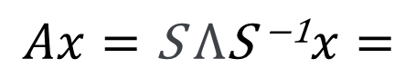
$$Ax=\text{S} \text{Λ}\text{S} \text{−1}x=$$

Slide 6



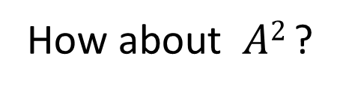
Powers of A
What are the eigenvalues and eigenvectors of A² ?
If $Ax=\text{λ}x$
Then$A2x=\text{A}\text{λ}x=\text{λ}\text{A}x=\text{λ}2x$
How about $A2$ ?
How about $Anx$ and $An$?

Slide 7

Markov matrices
A matrix like: $\left[\begin{matrix}0.1 & 0.99 & 0.3 \\ 0.2 & 0.01 & 0.3 \\ 0.7 & 0 & 0.4\end{matrix}\right]$
in which all entries are non-negative and each column adds to 1 is called a Markov matrix.
Property:
Max(abs(λ)=1
abs(λ)<=1

Slide 8
Max(abs(λ)=1
Proof:

Slide 9
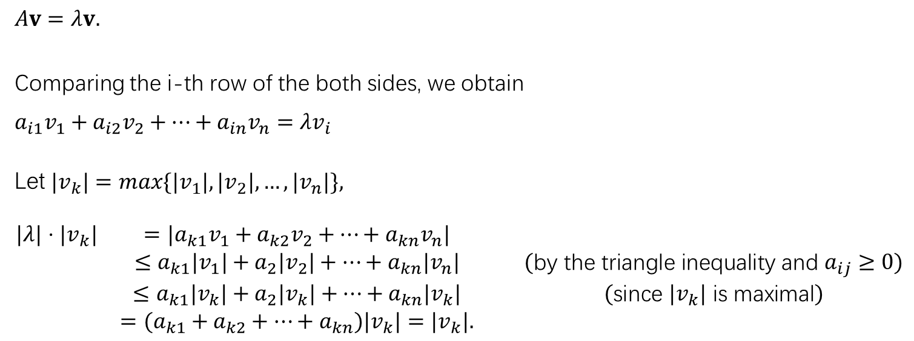
abs(λ)<=1
Proof:
$$Av=λv.$$
Comparing the i-th row of the both sides, we obtain
$$\begin{matrix}a_{i1}v_{1}+a_{i2}v_{2}+⋯+a_{in}v_{n}=λv_{i}\end{matrix}$$
Let $|v_{k}|=max\{|v_{1}|,|v_{2}|,…,|v_{n}|\},$
$$\begin{matrix}|λ|⋅|v_{k}| & =|a_{k1}v_{1}+a_{k2}v_{2}+⋯+a_{kn}v_{n}| & & \\ & ≤a_{k1}|v_{1}|+a_{2}|v_{2}|+⋯+a_{kn}|v_{n}| & & (\text{by} \text{the} \text{triangle} \text{inequality} \text{and} a_{ij}≥0) \\ & ≤a_{k1}|v_{k}|+a_{2}|v_{k}|+⋯+a_{kn}|v_{k}| & & (\text{since} |v_{k}| \text{is} \text{maximal}) \\ & =(a_{k1}+a_{k2}+⋯+a_{kn})|v_{k}|=|v_{k}|. & & \end{matrix}$$

Slide 10
PageRank
PageRank is a link analysis algorithm … with the purpose of "measuring" its (Webpage) relative importance within the set.
–From Wikipedia, the free encyclopedia

Slide 11
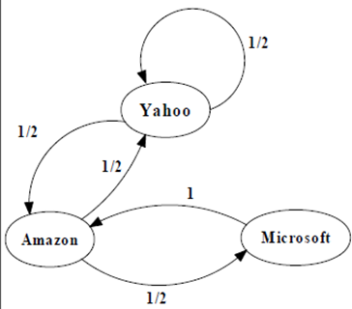
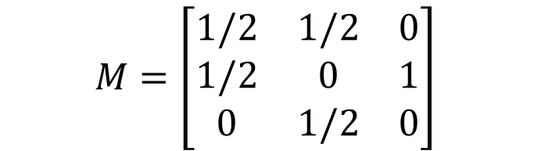
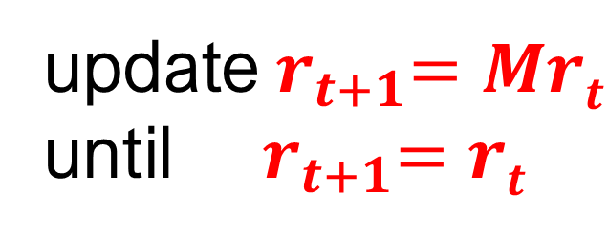
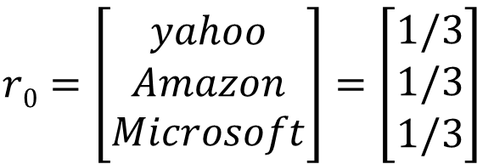
$$M=\left[\begin{matrix}1/2 & 1/2 & 0 \\ 1/2 & 0 & 1 \\ 0 & 1/2 & 0\end{matrix}\right]$$
$$r0=\left[\begin{matrix}yahoo \\ Amazon \\ Microsoft\end{matrix}\right]=\left[\begin{matrix}1/3 \\ 1/3 \\ 1/3\end{matrix}\right]$$
update${ r}_{t+1}=Mrt$
until ${ r}_{t+1}=rt$

Slide 12
Iteration | r
0 | 0.33 | 0.33 | 0.33
1 | 0.33 | 0.5 | 0.17
2 | 0.42 | 0.33 | 0.25
3 | 0.38 | 0.46 | 0.17
4 | 0.42 | 0.35 | 0.23
5 | 0.39 | 0.44 | 0.18
6 | 0.41 | 0.37 | 0.22
7 | 0.39 | 0.42 | 0.18
8 | 0.41 | 0.38 | 0.21
9 | 0.39 | 0.42 | 0.19
10 | 0.4 | 0.39 | 0.21
11 | 0.4 | 0.41 | 0.19
12 | 0.4 | 0.39 | 0.21
13 | 0.4 | 0.41 | 0.2
14 | 0.4 | 0.39 | 0.2
15 | 0.4 | 0.4 | 0.2
16 | 0.4 | 0.4 | 0.2
17 | 0.4 | 0.4 | 0.2
18 | 0.4 | 0.4 | 0.2
19 | 0.4 | 0.4 | 0.2
20 | 0.4 | 0.4 | 0.2

Slide 13
Why r is converged?
Let $\left[\begin{matrix}x1 & \begin{matrix}x2 & x3\end{matrix}\end{matrix}\right]$are independent eigenvector of M

Slide 14
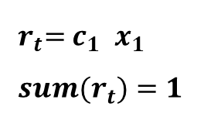
How to determine c₁ ?
${ r}_{t}={ c}_{1}$ ${ x}_{1}$
$${ sum(r}_{t})=1$$

